Slide 1
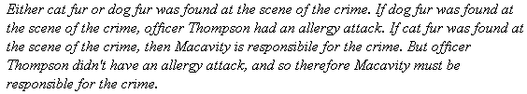
Deduction: Rule of Inference
1. Either cat fur was found at the scene of the crime, or dog fur was found at the scene of the crime. (Premise)
C v D

Slide 2
Deduction: Rule of Inference
2. If dog fur was found at the scene of the crime, then officer Thompson had an allergy attack. (Premise)
D → A

Slide 3
Deduction: Rule of Inference
3. If cat fur was found at the scene of the crime, then Macavity is responsible for the crime. (Premise)
C → M

Slide 4
Deduction: Rule of Inference
4. Officer Thompson did not have an allergy attack. (Premise)
¬ A

Slide 5
Rules for Inference:
Modus Tollens
If given α → β
and we know ¬β
Then ¬α

Slide 6
Deduction: Rule of Inference
2. If dog fur was found at the scene of the crime, then officer Thompson had an allergy attack. (Premise)
D → A
4. Officer Thompson did not have an allergy attack. (Premise)
¬ A
Result: (Applying Modus Tollens in equation 2 and 4)
¬ A

Slide 7
Deduction: Rule of Inference
Cat fur was found at the scene of the crime.
from 1 C v D
from 5 ¬ D.
Applying Disjunctive Syllogism
Conclusion: C

Slide 8
Rules for Inference:
Disjunctive Syllogism
If given α v β
and we know ¬α
then β
If given α v β
and we know ¬β
then α

Slide 9
Deduction: Rule of Inference
Macavity is responsible for the crime.
Follows from Step 3 C → M and Step 6 C).
Conclusion:
M

Slide 10
Rules for Inference:
Modus Ponens
If given α → β
and we know α
Then β

